Slide 1
TABLEAU FROMATTING VISUALIZATION & ANALYSIS
BY: TUSHAR GOEL
BDS BATCH
25 MAY.

Slide 2
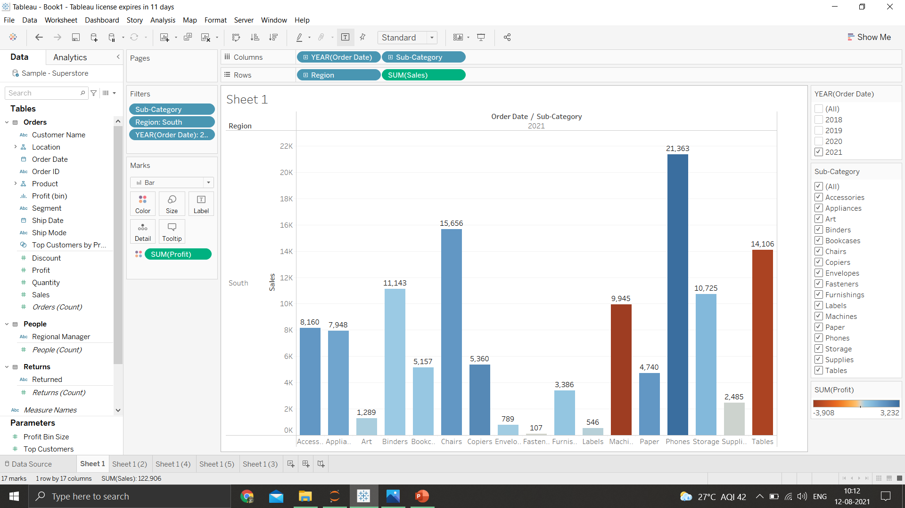
1.Find the profit & sales for each sub category of every type of product

Slide 3
2021
Accessories had profit 1947 & sales of 8160
Appliances had profit 1512 & sales of 7948
Art had profit of 279 & sales of 1289
Binders had profit of 406 and sales of 11143
Bookcases had profit of 514 & sales of 5157
Chairs had profit of 193 & sales of 15656
Copiers had profits of 2382 & sales of 5360
Envelopes Had profits of 336 & sales of 789
Fasteners have profits of 42 and sales of 107
Furnishings have profits of 569 and sales of 3386
Labels have profits of 336 & sales of 789
Machines have profit of -3908 & sales 9945
Paper had profits 1936 & sales of 4740
Phones Have profit 3232 & sales of 21363
Storage have profit of 992 & sales of 10725

Slide 4
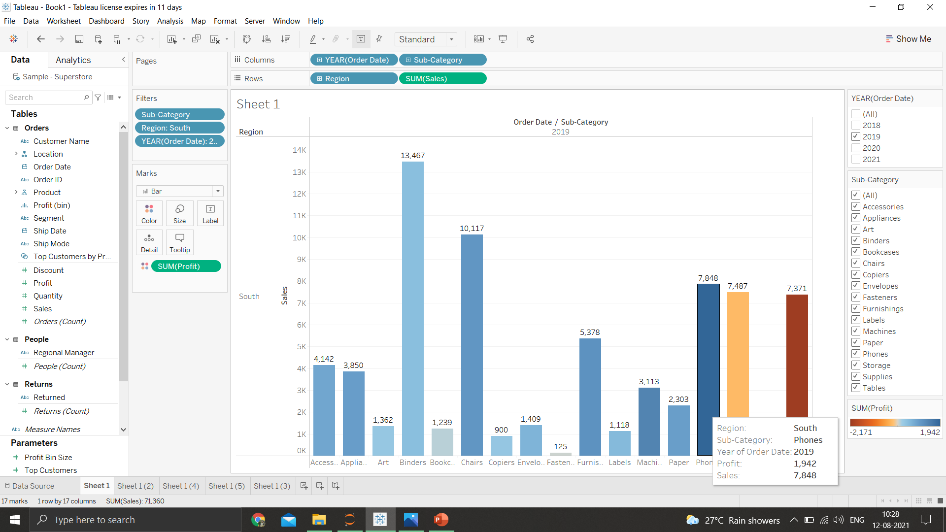
2.Which subcategory has the highest profit in the year 2019
Phones have the highest profits of 1942 in the year 2019

Slide 5
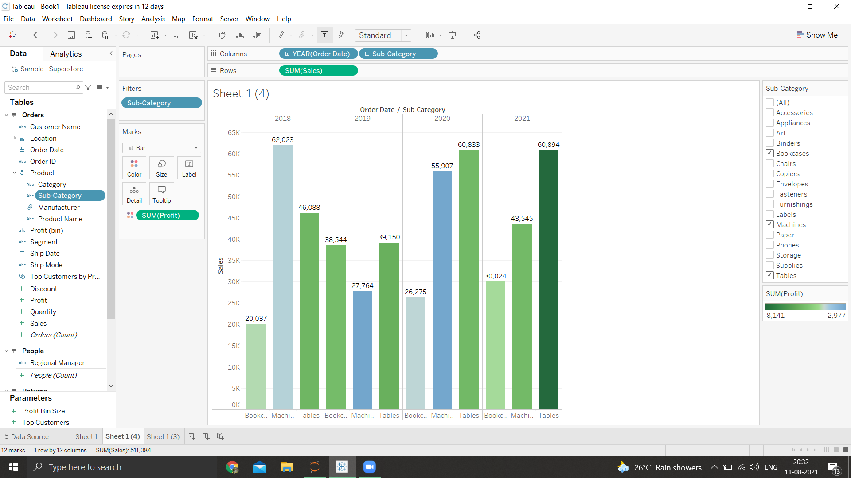
4.In the view, in the sub category filter card ,clear all of the check boxes except bookcases ,machines and tables to have closer look on each value

Slide 6
5.Find out the key insights about in which year bookcases & machines were profitable & unprofitable.
In year 2018,the profit for bookcases were 165 & the profit for machines were -3254
In year 2019,the profit for bookcases were 108 & the profit for machines were 1415
In Year 2020,the profit for bookcases were 553 & the profit for machines were 4308
In Year 2021,the profit for bookcases were 514 & the profit for machines were -3908
Overall we can say that there is steady growth in bookcases but a strong push should be done for the marketing and advertising for these products,because there is a year on year sales increase of 100%
Overall the sales have been dwindling downward from 2018 & never has reached the levels of 2018 on top of that the overall profit is a -1439 which says that the business model of the machines have to be changed in order to survive

Slide 7
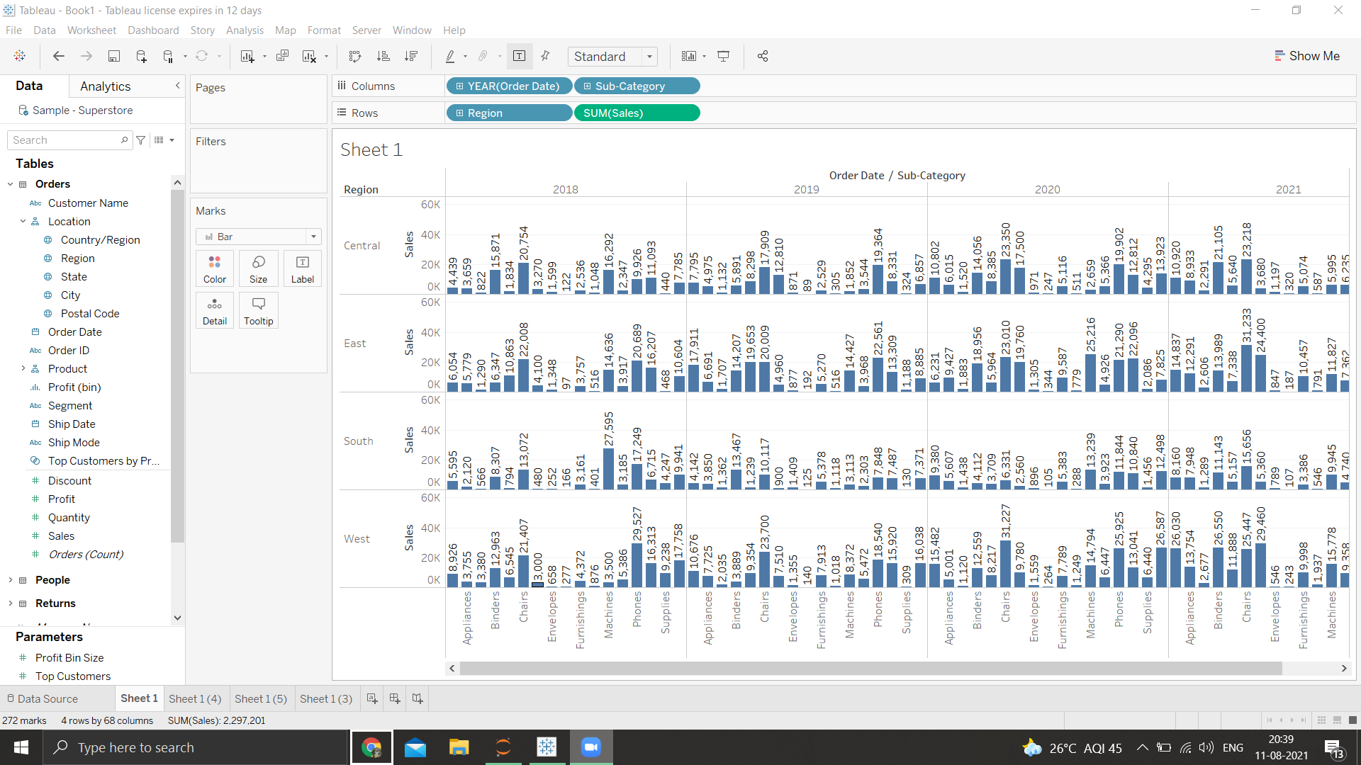
6.Show the sales region wise for every sub-category and every year

Slide 8
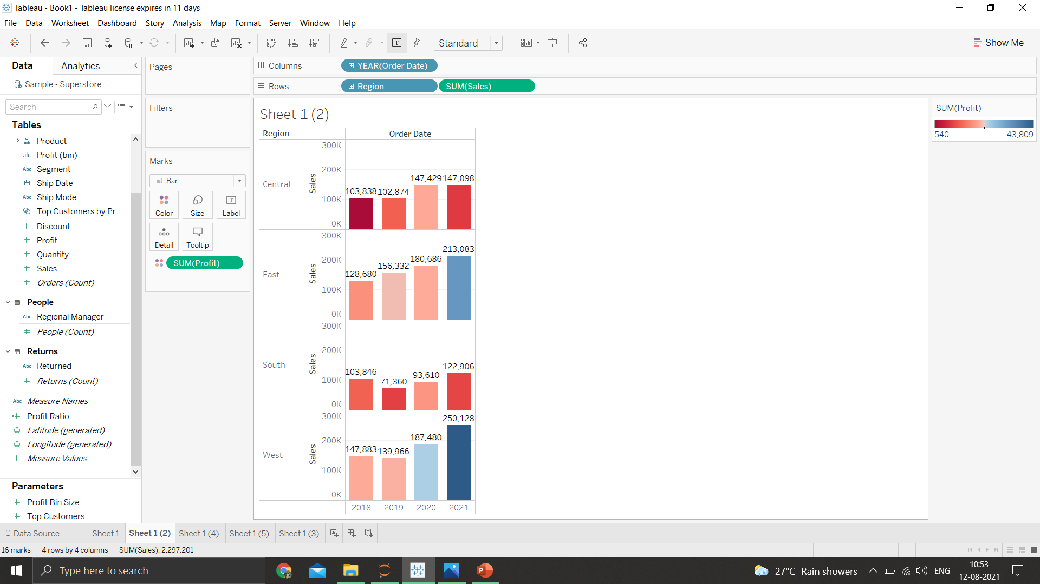
7.In which region are you reporting higher negative profit overall than in your other regions
The south is reporting the lowest profit compared to others.

Slide 9
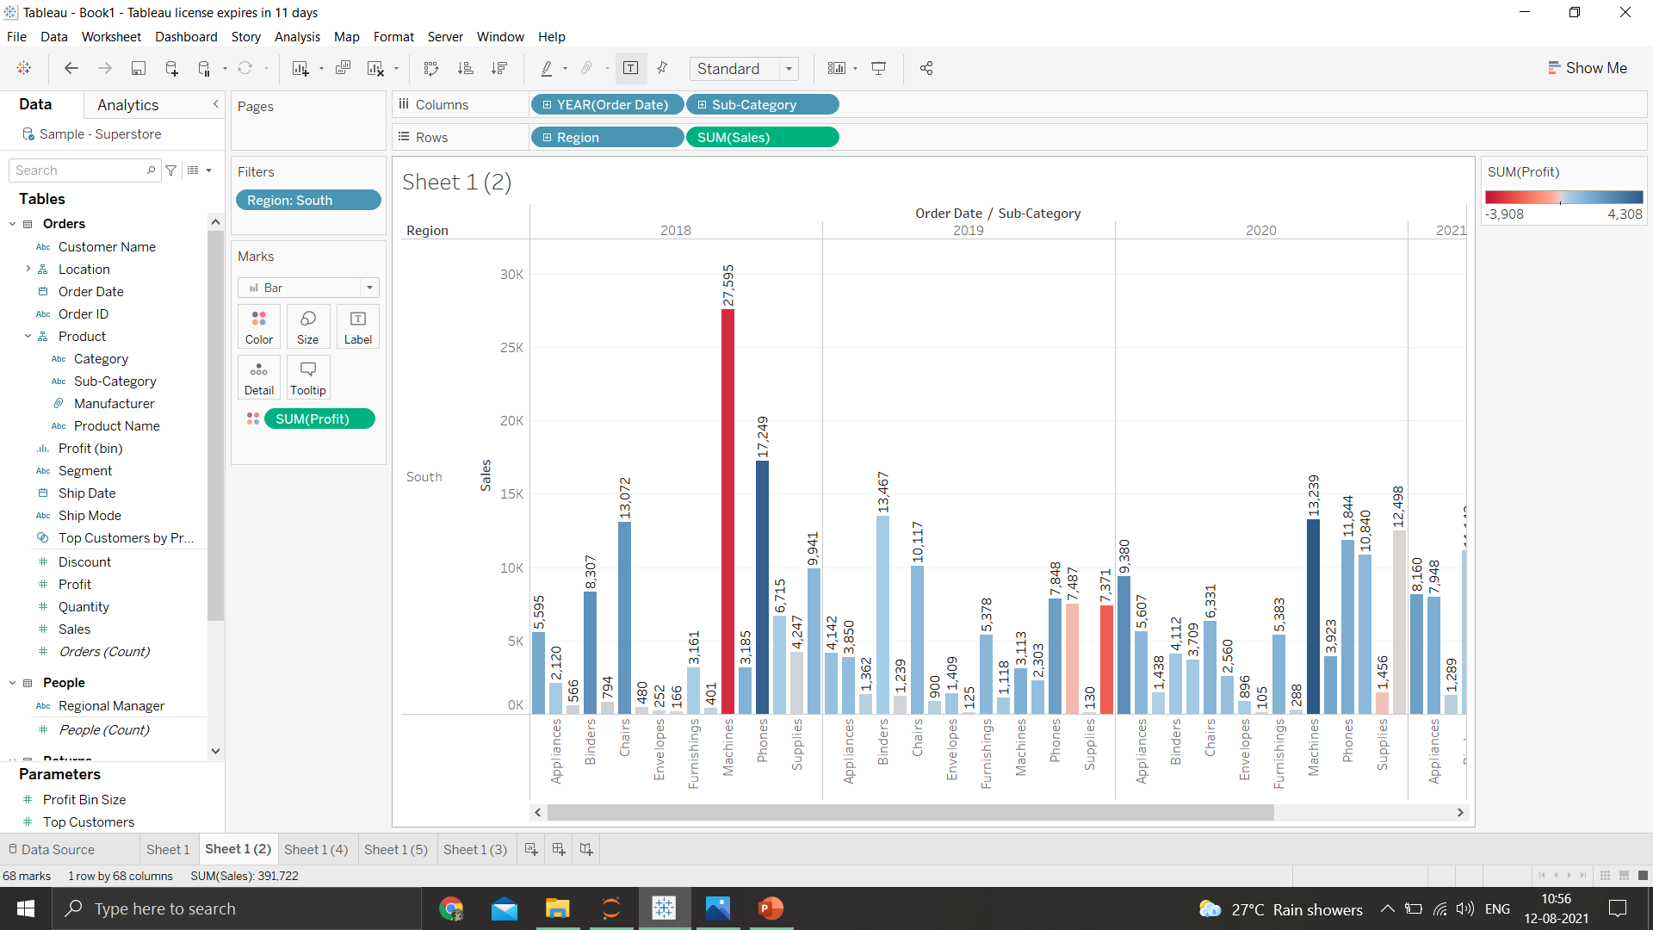
8.Show your view for sales in the south for all sub-category

Slide 10
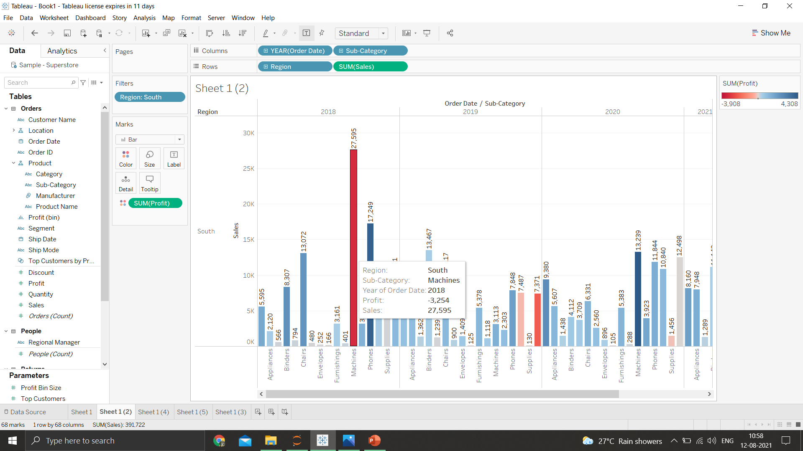
9.Which sub-category has the highest overall negative sales in the south region

Slide 11
10.Take some decisions to improve the sales in the south
As the models od the north, east & west have been making profits ,it would be a good idea to follow their business model in order to make profits in the long run
Also a deeper focus should be provided to the marketing and the advertising of the products for more sales meaning more profits.

